Slide 1

Machine Learning with Graphs
Yeshwant Singh
yeshwant.singh@ddn.upes.ac.in
SoCS, UPES, Dehradun

Slide 2
Machine Learning with Graphs I
Graph Neural Network
Understand how does Neural Network works
Notes:
Uni – 45 min, multi – 30min, break (15min), statistic – 1.5hr

Slide 3
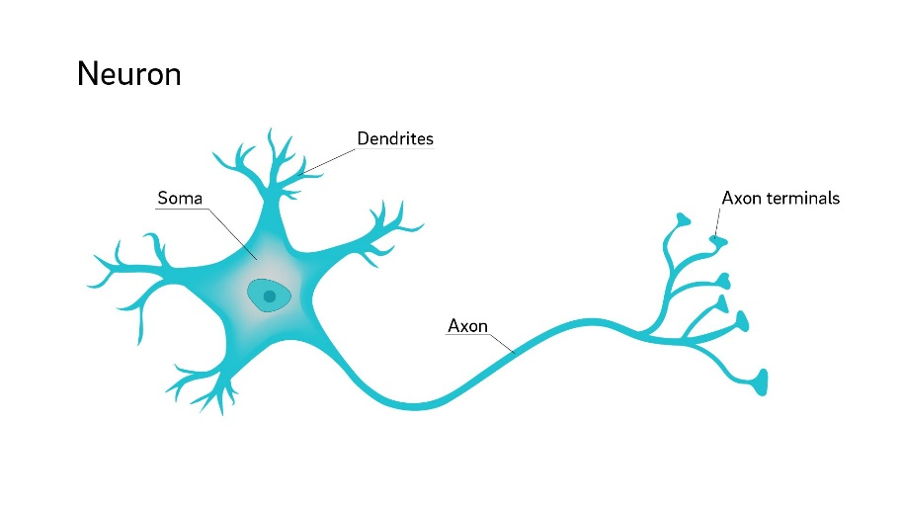
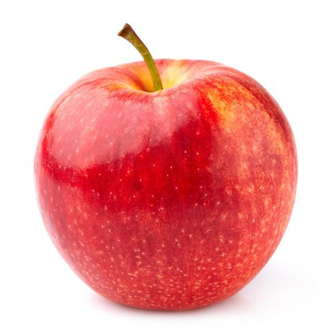
Neural Network
A computational model that can learn.
A model with parameters.
Learns the parameters from the data.
APPLE
Round Shape
Red color
Small Size
Notes:
Neural network is nothing but a computational model that can learn. The words neural comes from neuron, which is basic unit of the brain to interpret information. As we can see from here, the neuron has dendrites which takes in information, pass through the axon and output as terminals. To give an example, when we look at an apple, our eyes take in information such as the shape and the color in our brain and these information will pass through this neuron and interpret it as apple. So computer scientists make use of this intuition and design a computational model with parameters. The model will learn from the data.

Slide 4



How Neural Networks Learn
Human
Computer
Information
Reading
Past Experience
Notes:
In order to let the network to learn, we need data.

Slide 5
Neural Networks
Data:
Input (Age, BMI, Cholesterol level)
Output (Normal / High Blood Pressure)
We teach the model using the data to make accurate prediction by optimizing parameters
Age
Neural Networks
Normal blood pressure
BMI
High blood pressure
Cholesterol level
Notes:
In order to let the network to learn, we need data.

Slide 6
Neural Networks Basics
Made up of multiple layers of nodes
Input layer
Hidden layer
Output layer

Slide 7
Neural Networks Basics
Made up of multiple layers of nodes.
Each layer make simple decisions using different weights, w, bias, b and activation function, σ.
Learnable parameters
Input layer
Hidden layer
Output layer
b¹₁
σ
W²₁₁
W¹₁₁
W¹₁₂
b¹₂
W²₁₂
b²₁
σ
σ
b¹₃
b²₂
σ
σ
b¹₄
σ

Slide 8
Test: Neural Networks Basics
b¹₁
σ
W²₁₁
W¹₁₁
Age
W¹₁₂
b¹₂
W²₁₂
b²₁
σ
σ
Normal Blood Pressure
BMI
b¹₃
b²₂
σ
σ
High Blood Pressure
Cholesterol level
b¹₄
σ
Given the diagram, which of the following are learnable parameters?
A) Age
B)
σ
C)
W¹₁₁
D) All of the above

Slide 9
Neural Networks Training Process
Stop if obtain desired Accuracy / Loss
Compute Loss and Gradient
Initialized learnable-parameters
Feedforward Propagation
Backpropagation
Update Learnable-parameters

Slide 10
Feedforward Propagation
b¹₁
σ
W²₁₁
W¹₁₁
x₁
W¹₁₂
b¹₂
W²₁₂
b²₁
σ
σ
$$o1$$
x₂
b¹₃
σ
b²₂
σ
$$o2$$
x₃
b¹₄
σ
Feedforward

Slide 11
Feedforward Propagation
b¹₁
σ
W²₁₁
W¹₁₁
x₁
W¹₁₂
b¹₂
W²₁₂
b²₁
σ
σ
$$o1$$
W¹₂₁
x₂
W¹₃₁
b¹₃
b²₂
σ
σ
$$o2$$
x₃
b¹₄
σ

Slide 12
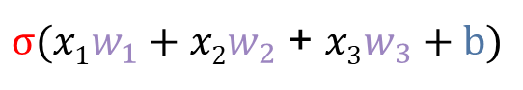
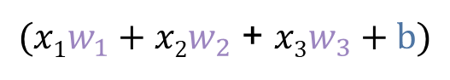
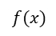
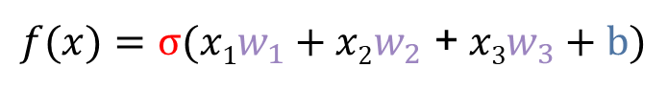
Feedforward Propagation (One Perceptron)
x₁
W₁
W₂
b
x₂
σ
$$f(x)$$
W₃
x₃
Input x Weight + Bias
$(x1w_{1}+x2w_{2}$ + $x3w_{3}+b)$
Apply Activation Function
$σ(x1w_{1}+x2w_{2}$ + $x3w_{3}+b)$
Obtain output
$f(x)=σ(x1w_{1}+x2w_{2}$ +$x3w_{3}+b)$

Slide 13
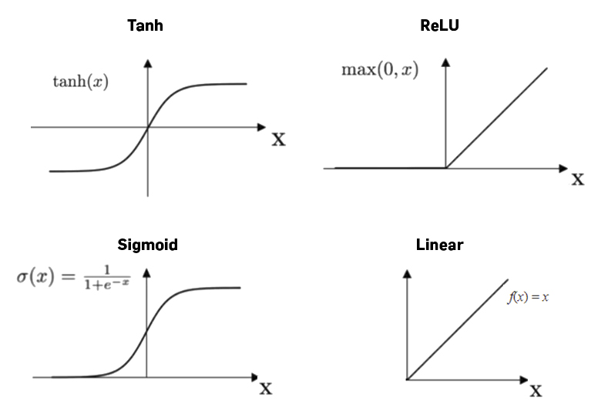

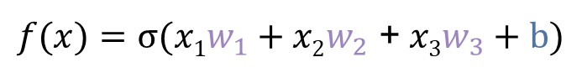
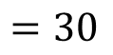
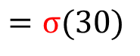
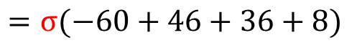
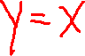
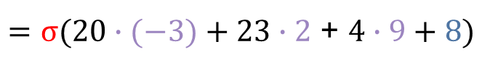
Activation Function
A mathematics function that determines the output of each perceptron in the neural network
$f(x)=σ(x1w_{1}+x2w_{2}$ +$x3w_{3}+b)$
$=σ(20∙(−3)+23∙2$ + $4∙9+8)$
$$=σ(−60+46+36+8)$$
$$σ\left(x\right)=x, for all x$$
$$=σ(30)$$
$$=30$$

Slide 14
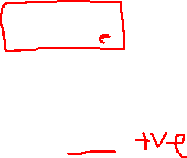
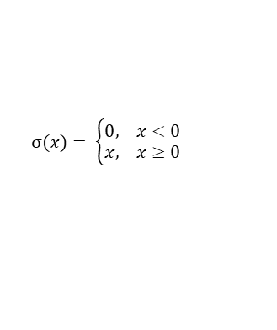
Activation Function
$σ(x)= \left\{\begin{matrix}0, x<0 \\ x, x≥0\end{matrix}\right.$
Given ReLU activation, what is the output of $σ(x)$ if x = 13?
A) 13
B) 0
C) -9
D) 21
Given ReLU activation, what is the output of $σ\left(x\right) \text{if} \text{x}\text{ = }\text{−}\text{13?}$
A) 13
B) 0
C) -9
D) 21

Slide 15
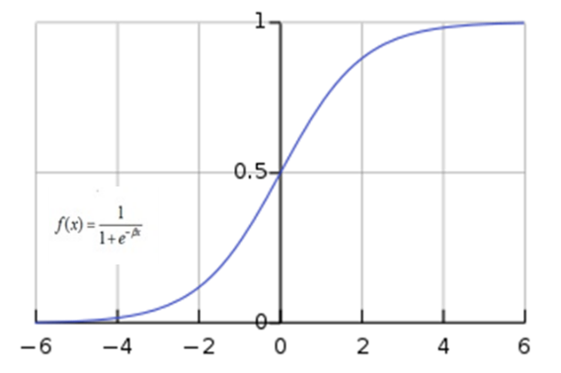
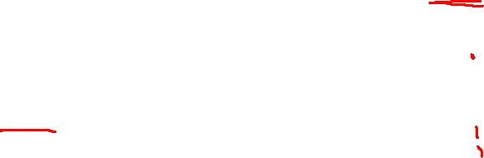
Activation Function
Common activation functions:
Softmax

Slide 16
Why different activation functions?
Normal Blood Pressure
High Blood Pressure
Scenario 1
Scenario 3
Input space:
Age, BMI, cholesterol level
Input space:
Age, BMI, cholesterol level
Decision Boundary
Decision Boundary
Scenario 2
Scenario 4
Input space:
Age, BMI, cholesterol level
Decision Boundary
Input space:
Age, BMI, cholesterol level
Decision Boundary

Slide 17
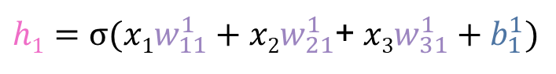
Feedforward All Perceptrons
Feedforward Neural Network
Input x Weight + Bias
h₁
b¹₁
$h1=σ(x1w_{11}^{1}+x2w_{21}^{1}$+$x3w_{31}^{1}+b_{1}^{1})$
σ
W²₁₁
W¹₁₁
x₁
W¹₁₂
b¹₂
W²₁₂
b²₁
h₂
σ
Activation function
W¹₂₁
σ
$$o1$$
x₂
W¹₃₁
h₃
b¹₃
b²₂
σ
σ
$$o2$$
x₃
h₄
b¹₄
σ
Feedforward

Slide 18
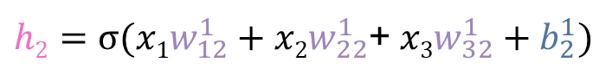
Feedforward All Perceptrons
h₁
b¹₁
$h1=σ(x1w_{11}^{1}+x2w_{21}^{1}$+$x3w_{31}^{1}+b_{1}^{1})$
σ
W²₁₁
W¹₁₁
x₁
W¹₁₂
b¹₂
W²₁₂
b²₁
h₂
σ
$h2=σ(x1w_{12}^{1}+x2w_{22}^{1}$+$x3w_{32}^{1}+b_{2}^{1})$
σ
$$o1$$
W¹₂₂
x₂
h₃
b¹₃
b²₂
W¹₃₂
σ
σ
$$o2$$
x₃
h₄
b¹₄
σ
Feedforward

Slide 19
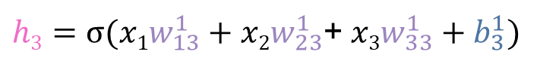
Feedforward All Perceptrons
h₁
b¹₁
$h1=σ(x1w_{11}^{1}+x2w_{21}^{1}$+$x3w_{31}^{1}+b_{1}^{1})$
σ
W²₁₁
W¹₁₁
x₁
b¹₂
W²₁₂
b²₁
h₂
σ
$h2=σ(x1w_{12}^{1}+x2w_{22}^{1}$+$x3w_{32}^{1}+b_{2}^{1})$
W¹₁₃
σ
$$o1$$
x₂
W¹₂₃
h₃
b¹₃
b²₂
$h3=σ(x1w_{13}^{1}+x2w_{23}^{1}$+$x3w_{33}^{1}+b_{3}^{1})$
σ
σ
W¹₃₃
$$o2$$
x₃
h₄
b¹₄
σ
Feedforward

Slide 20
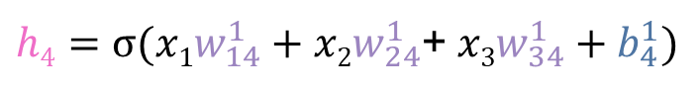
Feedforward All Perceptrons
h₁
b¹₁
$h1=σ(x1w_{11}^{1}+x2w_{21}^{1}$+$x3w_{31}^{1}+b_{1}^{1})$
σ
W²₁₁
W¹₁₁
x₁
b¹₂
W²₁₂
b²₁
h₂
σ
$h2=σ(x1w_{12}^{1}+x2w_{22}^{1}$+$x3w_{32}^{1}+b_{2}^{1})$
σ
$$o1$$
W¹₁₄
x₂
h₃
b¹₃
b²₂
$h3=σ(x1w_{13}^{1}+x2w_{23}^{1}$+$x3w_{33}^{1}+b_{3}^{1})$
W¹₂₄
σ
σ
$$o2$$
x₃
W¹₃₄
h₄
b¹₄
$h4=σ(x1w_{14}^{1}+x2w_{24}^{1}$+$x3w_{34}^{1}+b_{4}^{1})$
σ
Feedforward

Slide 21
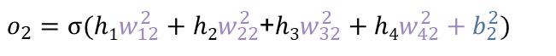
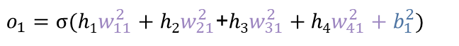
Feedforward All Perceptrons
input
h₁
b¹₁
σ
W²₁₁
W¹₁₁
x₁
h₂
b¹₂
W²₁₂
b²₁
σ
σ
$$o1=0.4$$
$o_{1}=σ(h1w_{11}^{2}+h2w_{21}^{2}$+$h3w_{31}^{2}+{h4w_{41}^{2}+b}_{1}^{2})$
W¹₁₄
x₂
h₃
b¹₃
b²₂
W¹₂₄
σ
σ
$o_{2}=σ(h1w_{12}^{2}+h2w_{22}^{2}$+$h3w_{32}^{2}+{h4w_{42}^{2}+b}_{2}^{2})$
$o2=0.2$
x₃
W¹₃₄
h₄
b¹₄
σ
W²₄₂
Feedforward

Slide 22
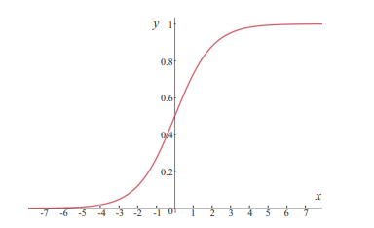
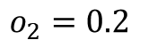
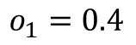
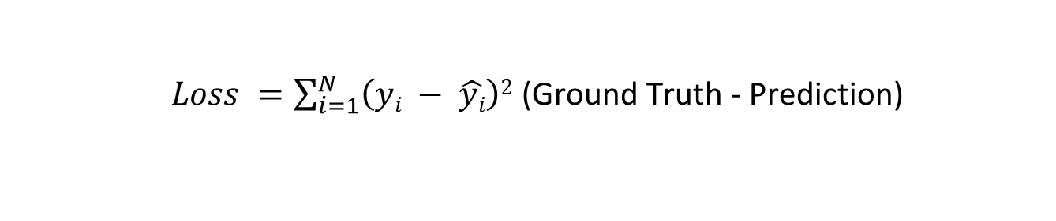
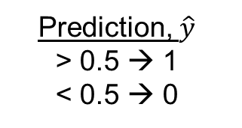
Loss
$$o_{1}=0.4$$
Sigmoid function
Output Probability
Prediction, $\hat{y}$
> 0.5 → 1
< 0.5 → 0
$o_{2}=0.2$
Ground Truth
Normal blood pressure, y = 0
High blood pressure, y=1
$Loss =\sum_{i=1}^{N}{\left(yi − \hat{yi}\right)2}$ (Ground Truth - Prediction)

Slide 23
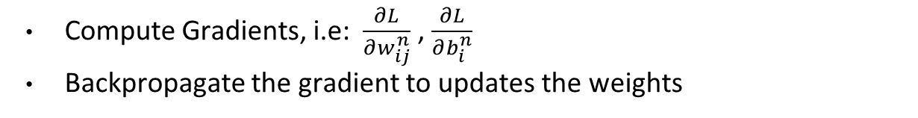
Backpropagations to update weight
Compute Gradients, i.e: $\frac{∂L}{∂w_{ij}^{n}}$ , $\frac{∂L}{∂b_{i}^{n}}$
Backpropagate the gradient to updates the weights
b¹₁
σ
W²₁₁
W¹₁₁
Age
W¹₁₂
b¹₂
W²₁₂
b²₁
σ
σ
$$o_{1}=0.4$$
BMI
b¹₃
b²₁
σ
σ
$o_{2}=0.2$
Cholesterol level
b¹₄
σ
Backpropagation

Slide 24
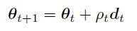
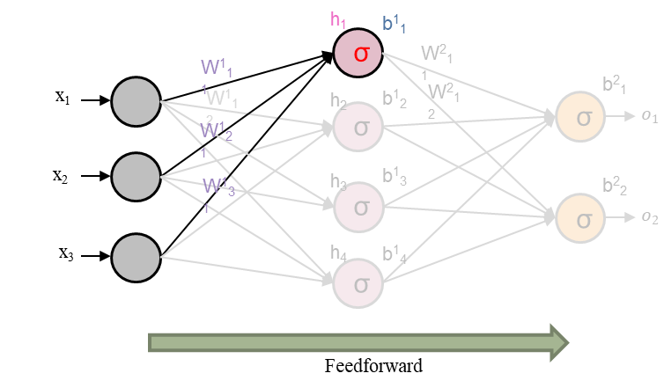
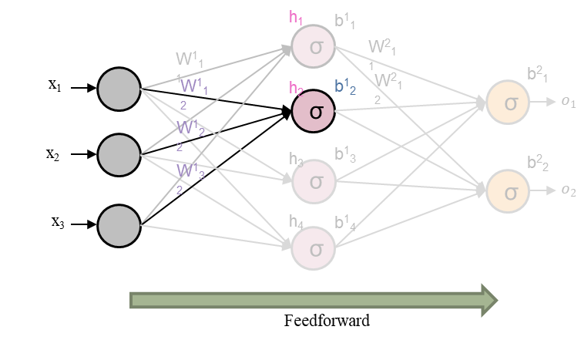
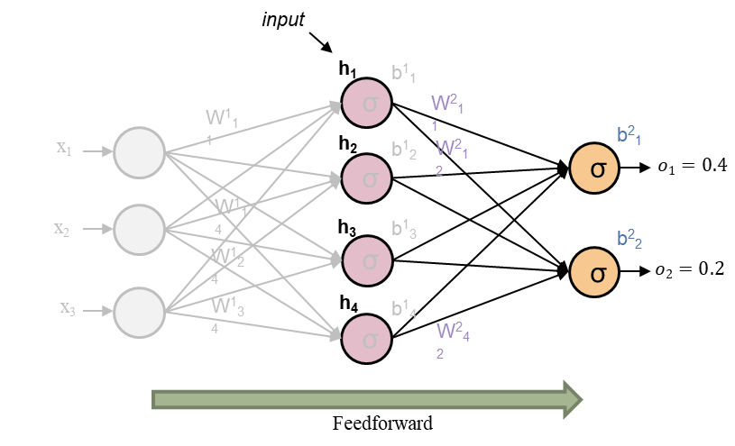
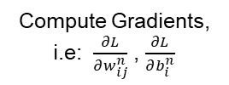
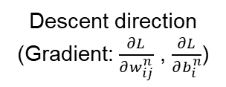
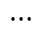
Gradient Descent
Updated parameter (weight, bias)
Descent direction (Gradient: $\frac{∂L}{∂w_{ij}^{n}}$ , $\frac{∂L}{∂b_{i}^{n}}$)
Compute Gradients, i.e: $\frac{∂L}{∂w_{ij}^{n}}$ , $\frac{∂L}{∂b_{i}^{n}}$
Step size
$$⋯$$

Slide 25
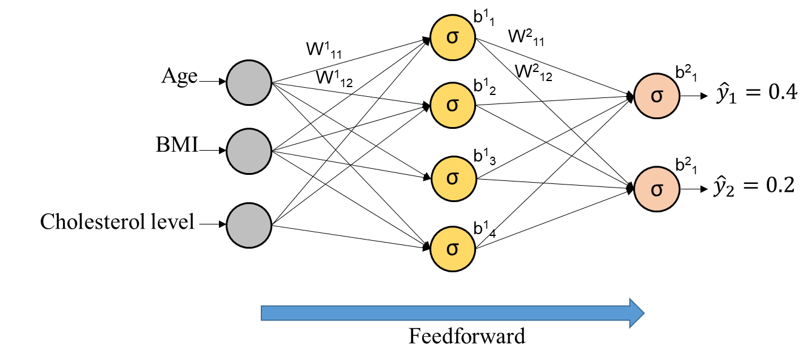
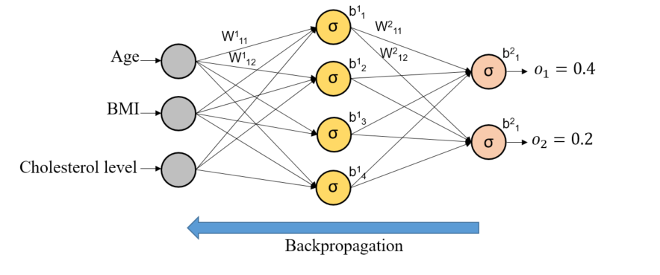
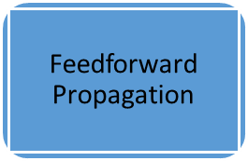
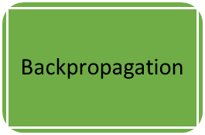
Training Iteratively until Loss ~ 0
Compute Loss and Gradient
Update Weight

Slide 26
Summary Neural Networks Training Process
Stop if obtain desired Accuracy / Loss
Compute Loss and Gradient
Initialized learnable-parameters
Feedforward Propagation
Backpropagation
Weight
Bias
Update Learnable-parameters
Weight
Bias

Slide 27

Your Task
Draw a flow chart and write the description of the Neural Network training process in your own words.
Put it onto forum

Slide 28
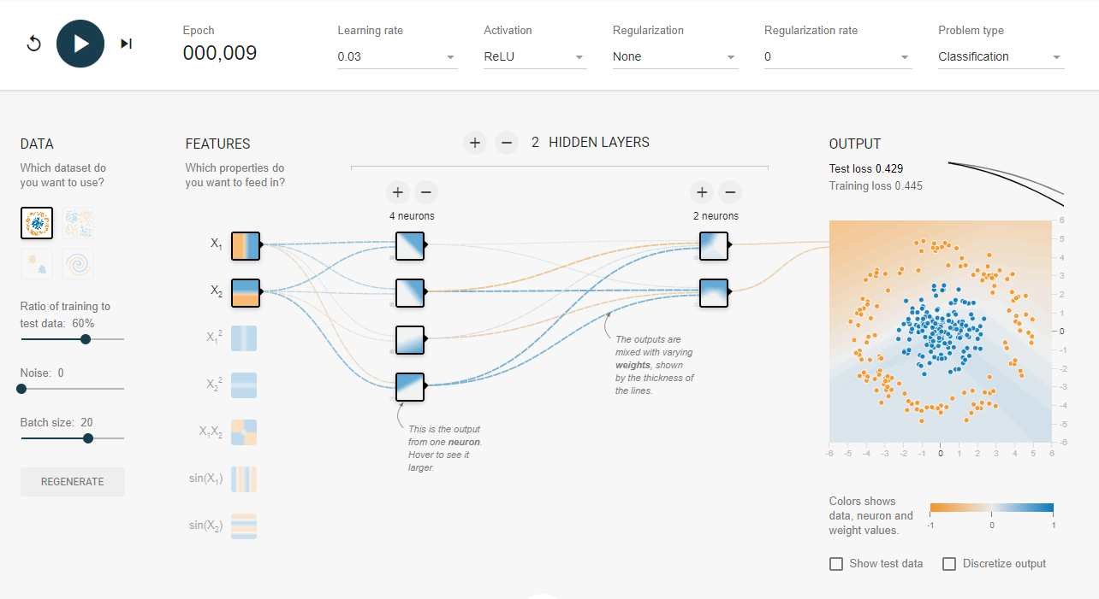
Visualization
Animation – Search for Playground Tensorflow

Slide 29
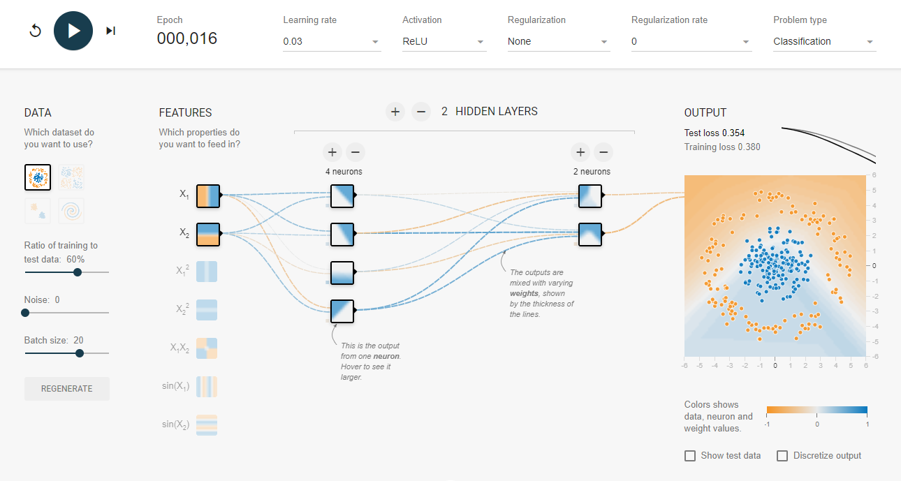
Visualization

Slide 30
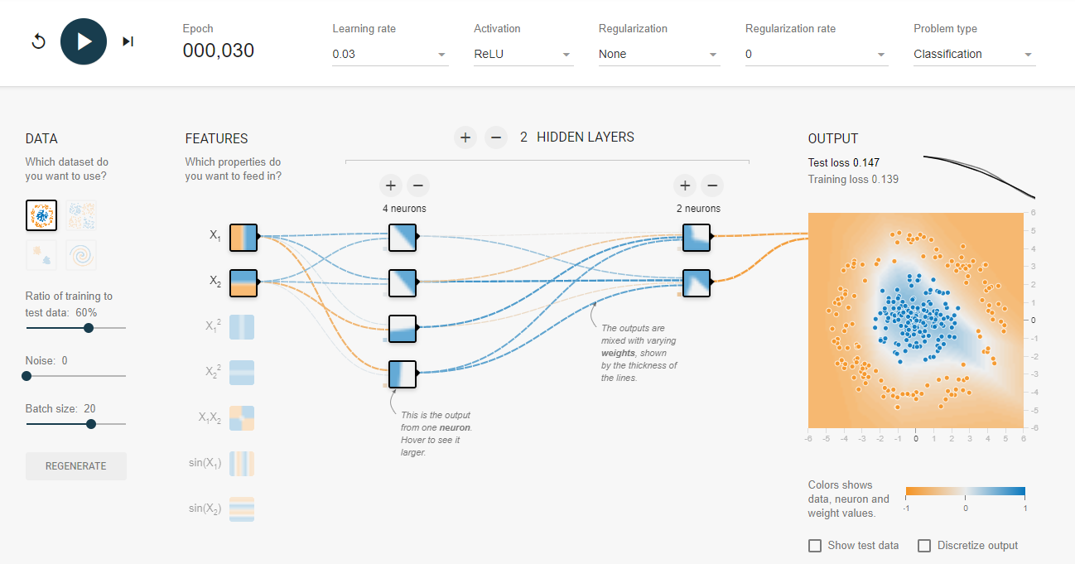
Visualization

Slide 31
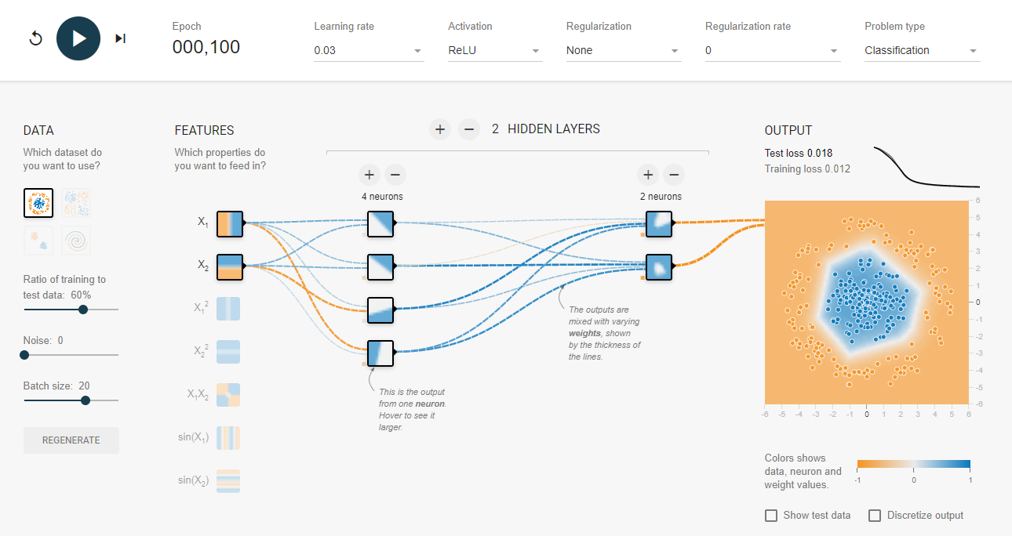
Visualization

Slide 32
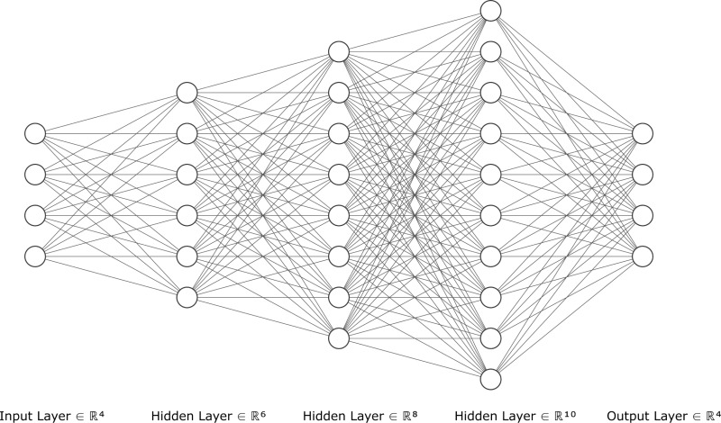
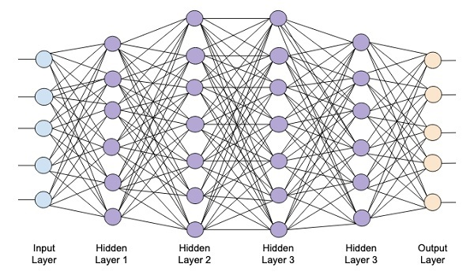
Larger Network
Increase number of node
Increase number of hidden layer

Slide 33
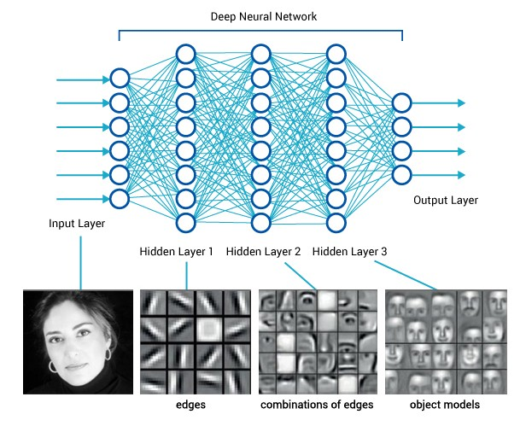
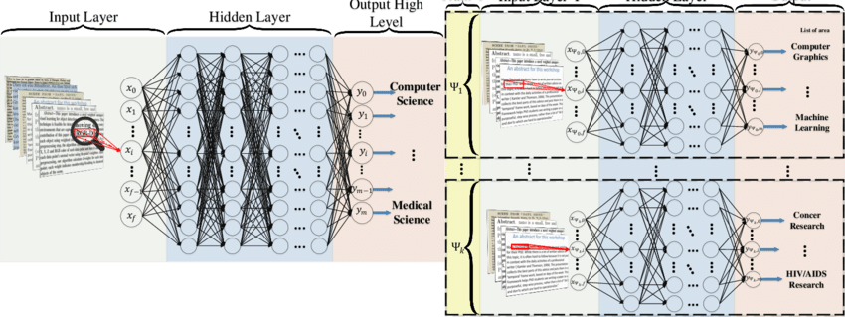
Larger Network
Kowsari et al. HDLTex: Hierarchical Deep Learning for Text Classification
Figure from https://medium.com/diaryofawannapreneur/deep-learning-for-computer-vision-for-the-average-person-861661d8aa61

Slide 34
Larger Network
The larger the better???
No → overfitting (layman term – memorize training data only, poor performance when testing data is used)
What the reason of overfitting??? One of the reason is we have too many parameters
Why do I say so?

Slide 35
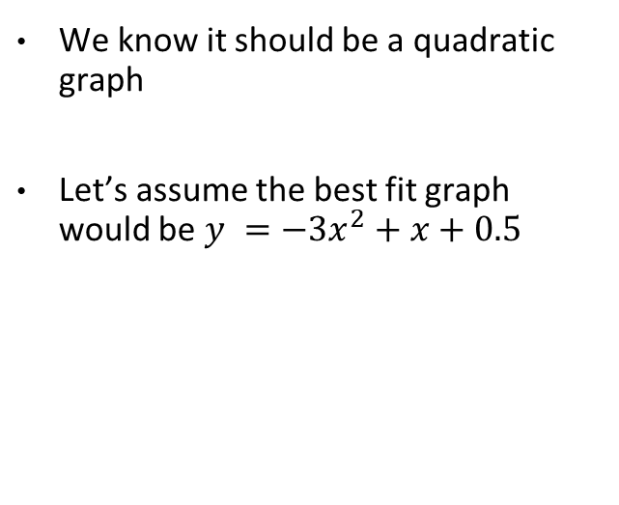
Overfitting
If we have the following graph
We know it should be a quadratic graph
Let’s assume the best fit graph would be $y =−3x^{2}+x+0.5$

Slide 36
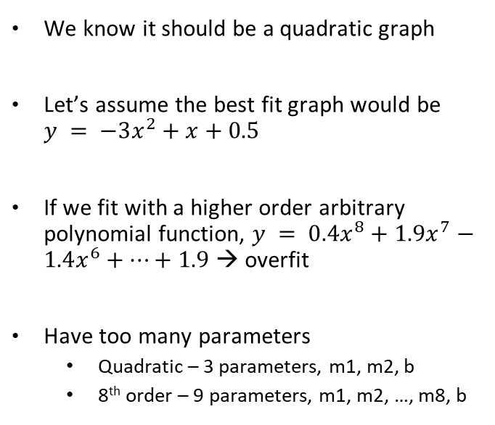

Overfitting
If we have the following graph
We know it should be a quadratic graph
Let’s assume the best fit graph would be $y = −3x^{2}+x+0.5$
If we fit with a higher order arbitrary polynomial function, $y = 0.4x^{8}+1.9x^{7}−1.4x^{6}+⋯+1.9$ → overfit
Have too many parameters
Quadratic – 3 parameters, m1, m2, b
8th order – 9 parameters, m1, m2, …, m8, b

Slide 37
Overfitting
Reason: Have too many parameters
How to solve???
Reduce the model size → number of node / hidden layer

Slide 38

Larger Network
Another reason of overfitting is the weight value are too big.
Remember previous slide (week4)? We observed that the value of weight increase in overfitting model.

Slide 39
Larger Network
Another reason of overfitting is the weight value are too big.
Remember previous slide (week4)? We observed that the value of weight increase in overfitting model.
To solve this, we regularize the weight value – don’t let it grow too large via Batch Normalization
Batch Normalization → normalize each layer to z-score (0 mean, 1 stdev)

Slide 40

Overfitting
Another way to solve: Use the idea of ensemble model
Ensemble model → train multiple model then combine all of them.
High computational cost

Slide 41

Dropout
Randomly drop the node
1st iteration (Model1)
2nd iteration (Model2)
3rd iteration (Model3)
Forward
Compute gradient
Update weight
Forward
Compute gradient
Update weight
Forward
Compute gradient
Update weight
Idea: Train different model at every iteration.

